Slide 1
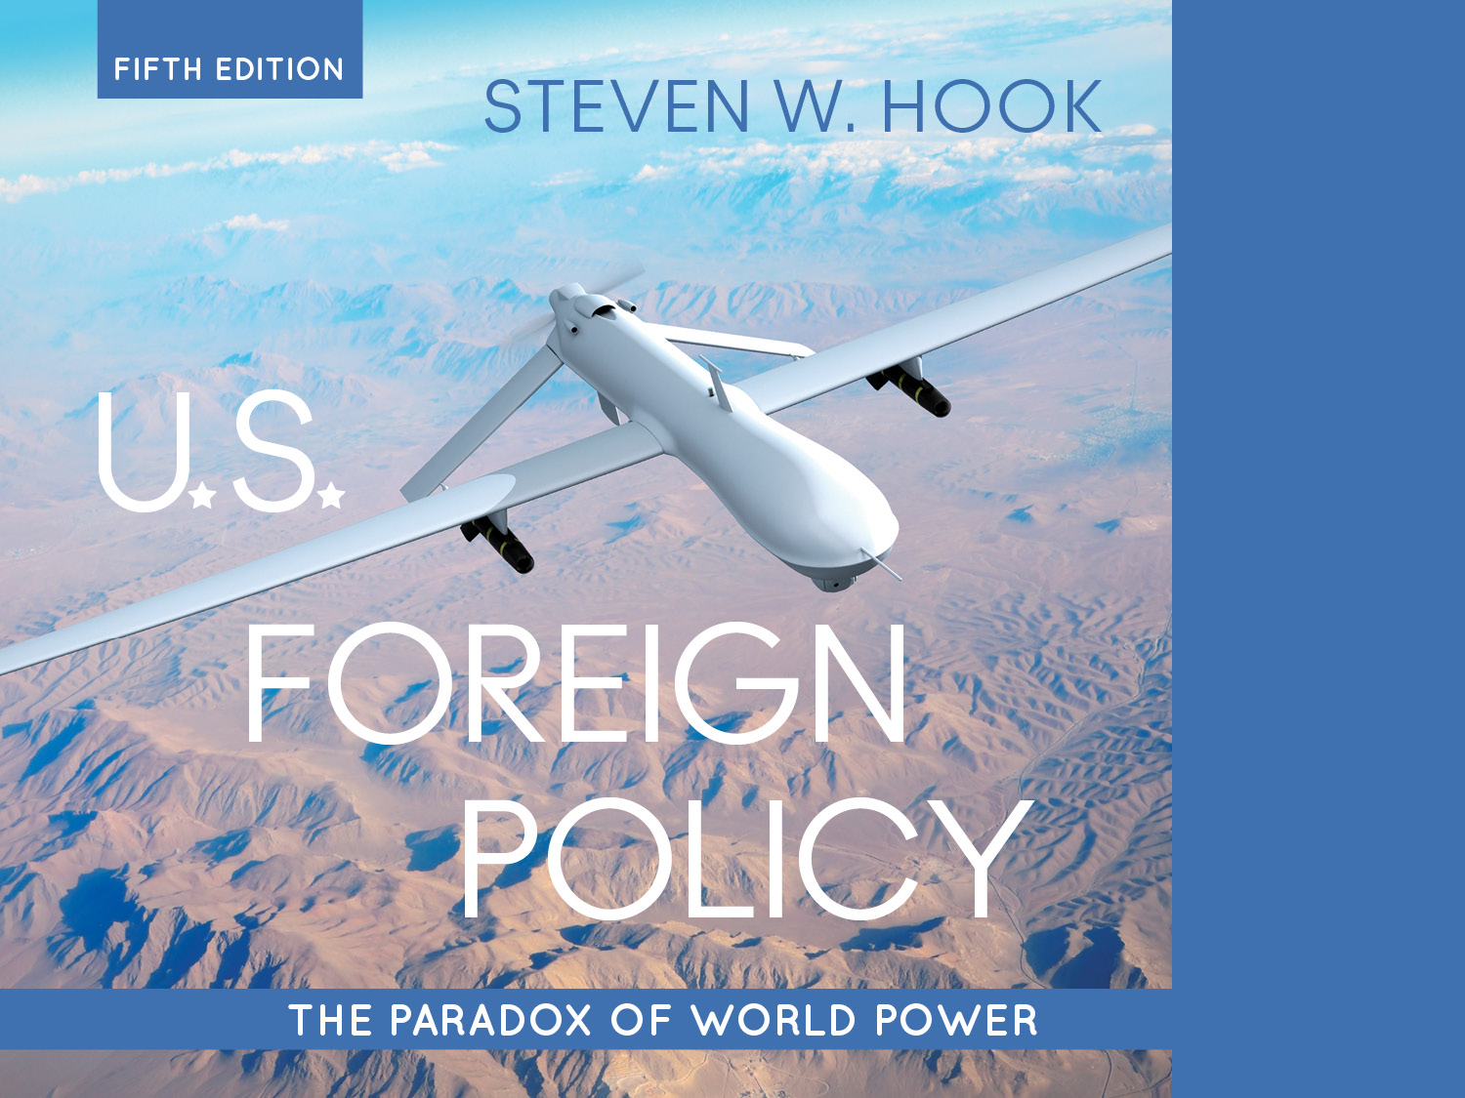
4. Presidential Power

Slide 2
Learning Objectives:
Discuss how the powers and constraints of the constitution influence the presidents role in foreign policy
Identify the ways that presidential prerogative is evident in three areas of US foreign policy
Describe the White House centered structure of foreign policy decision making and how it has changed over time

Slide 3
Chapter 4 Outline
I. The Constitution’s Mixed Blessing (Today)
a. The Sharing of Foreign Policy Powers
b. White House Advantages Over Congress
c. Constraints on Presidential Power
II. Presidential Prerogative in the “Zone of Twilight” (Wed)
a. Setting the Foreign Policy Agenda
b. Organizing the Chain of Command
c. Taking the Initiative
III. Structures of the “Presidential Branch” (Wed)
a. Advisory Systems in the Inner Circle
b. The Vice President’s Expanding Roles
IV. Judicial Interventions in Foreign Policy (Wed)
a. Rulings on Executive and Federal Power
b. Legal Quandaries in the War on Terror

Slide 4
Concentration of Presidential Power:
Since WWII, foreign policy making has been captured by an increasingly strong and unilaterally-acting executive branch
NSC moved decision making from the Pentagon and State Department to the White House
Johnson in Vietnam
Clinton in Yugoslavia
Bush in Afghanistan and Iraq
Obama’s intervention in Libya
Notes:
NSC creation important because it moved power closer to the White House, and away from the state department
What about Donald Trump? Can we think of examples here?

Slide 5
The Constitution’s Mixed Blessing
Theodore Roosevelt’s stewardship theory
The president represents all people and should be a steward of the people
The president should be active in foreign and domestic policy
The president should be constrained only by specifics in the Constitution and the law
Prerogative powers: Autonomy and independence from other agencies for foreign policy making
Notes:
Learning Objective Number: 4.1

Slide 6
The Constitution’s Mixed Blessing
Codetermination: The sharing and splitting of foreign policy powers among the three branches
The power to set and conduct the foreign policy agenda evolved to the president
Executive branch buildup, growth, and control
Vague on foreign policy
Shared powers of the president and Congress
Hamiltonian vs Madisonian/Jeffersonian ideas
Discussion question: Why hamstring the U.S. in this way?
Notes:
Definitely want to talk about the early founders aversion against unrestricted Monarchical power, power should be constrained domestically and internationally.

Slide 7
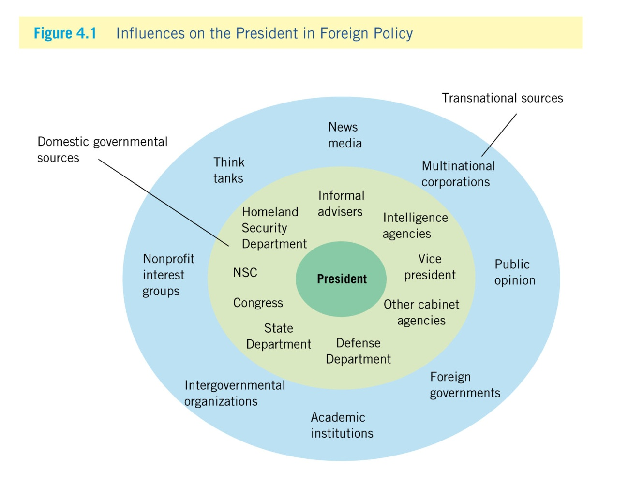
Presidential Power
Notes:
Learning Objective Number: 4.1

Slide 8
The Sharing of Foreign Policy Powers
Commander-in-chief
Formal declaration of war has not been used since World War II
Centralization of armed forces under the president
Members of Congress allow president broad authority with troops deployed
Presidents control agencies and cabinets used during war
NSC convened and staffed by president
Defense secretary appointed by president
Notes:
Why do you want the president to be fully in charge of this, or any one person for that matter?
Why does congress not push back more against this?
On what charge are President’s often criticized when it comes to the conduct of warfare?

Slide 9
The Sharing of Foreign Policy Powers
Treaties and international agreements
Easier for one person to negotiate, conduct diplomacy
Senate approval needed for ratification
Treaties uncommon; executive agreements common
Senate approval not needed on executive agreements, unlike treaties
Increased use of executive agreements over treaties
Used 90% of the time between 1939 and 2000
Notes:
Why is the use of executive agreements more attractive to many presidents than negotiating treaties?

Slide 10
The Sharing of Foreign Policy Powers
Presidential appointments
Responsible for picking cabinet members and ambassadors
Rarely challenged by Congress
Staff positions such as national security adviser are not subject to congressional approval
Recess appointments and special advisor appointments
Conducting diplomacy
Constitution is vague over day-to-day operations
Receiving ambassadors, foreign diplomats, and public ministers
Recognizing foreign governments
Notes:
Learning Objective Number: 4.1

Slide 11
White House Advantages over Congress
Informal powers: Norms, routines, and natural advantages for the president in foreign affairs
National constituency: The president represents all the people
Bully pulpit: Unparalleled access to the general public through media
Status as party leader: The president is at the head of the political party and of the party in government
Perpetual session: Unlike Congress, the president is always “in session” and is a unitary actor
The bureaucracy’s CEO: Leadership or control of executive agencies
Information dominance: Information and resource control, specifically by councils and agencies of national security
Notes:
Learning Objective Number: 4.1

Slide 12
Constraints on Presidential Power
Domestic and international factors to consider as constraints on presidential power
Developments overseas: Uncertainty regarding international conditions, emergence of crises
September 11 attacks
Russia’s annexation of Crimea
Domestic politics: Party control of Congress
Personal limitations: Time, personal background, psychology, and available information all impact decision-making
Notes:
Issue of experience in foreign policy, or lack thereof.

Slide 13
Constraints on Presidential Power
Foreign policy issues also vary with administrations, and crises can affect foreign policy
Time
Resources
Partisan politics
Elections
Media
Public opinion
The importance of context.
What is the current context of presidential foreign policy power?
Notes:
Learning Objective Number: 4.1

